Slide 1
Lipid Digestion and Absorption
Notes:
Ran out of time with first presentation
Fix notes to indicate most digestion occurs in the small intestine, was unclear
Find better image for micelles
Talk more about cholesterol regulation

Slide 2
Quiz Question #1
Where does the majority of lipase activity occur?
Mouth and esophagus
Stomach
Small Intestine
Large Intestine

Slide 3
Quiz Question #2
Which enzyme requires colipase for its activity?
Cholesterol esterase
Lingual lipase
Gastric lipase
Pancreatic lipase

Slide 4
Quiz Question #3
What tissue synthesizes chylomicrons
Liver cells
Bile ducts
Enterocytes
Adipocytes

Slide 5
Lipid Digestion and Absorption Learning Objectives
Identify the roles of lingual lipase, gastric lipase and pancreatic lipase including their locations and specific roles on lipid digestion in the stomach
Understand the role of bile salts in the formation of micelles, and explain how diseases of bile formation can affect an individual
Explain the transport mechanisms of lipids across the apical and basolateral membranes, and how they differ between lipid classes
Describe the re-esterification processes in the enterocyte
Explain the nature, formation and fate of the chylomicron and its role in lipid transportation

Slide 6
Sesame & Sesame oil
bowel movements
Yuting Huang

Slide 7
Sesame
is a flowering plant in the genus Sesamum, also called benne Sesame
Sesame seed is one of the oldest oilseed crops known, domesticated well over 3000 years ago.

Slide 8
Chemical composition
Sesame seeds contain the lignans sesamolin, sesamin, pinoresinol and lariciresinol
https://en.wikipedia.org/wiki/Sesame

Slide 9
Sesame Oil
Derived from sesame
Sesame oil contains 15 percent saturated fat
42 percent oleic acid and 43 percent omega-6 linoleic acid
Sesame oil has natural antibacterial, antiviral and antioxidant properties
https://articles.mercola.com/herbal-oils/sesame-oil.aspx

Slide 10
How??
Regular consumption of sesame oil in diet may improve certain inflammatory conditions of the alimentary canal, like IBS, IBD, Ulcerative Colitis and Crohn’s disease.
Lubricates the Colon
Sesame seeds are rich in fiber, which is known to pave way for a healthy digestive system and a healthy colon
Enhances Good Bacteria in Your Intestines
http://oilhealthbenefits.com/sesame-oil/
http://www.poopdoc.com/articles/constipationinremedynatural.html

Slide 11
Conclusion
There has been several studies emphasizing the benefits of sesame oil in improving bowel movements and helping people suffering from constipation.
However, there hasn’t been an in-depth scientific study on this topic relating sesame oil and constipation.

Slide 12
My Question
In this case, should we believe the articles we find online?

Slide 13
Your Question

Slide 14
Dietary Lipids
Triacylglycerols
Main lipid of diets
Provides essential FAs (polyunsaturated)
Average daily dietary intake:
Men: 95g
Women: 65g
Sterols (cholesterol) and phospholipids
Cholesterol average intake 300 mg/day (animal products)
1-2 g/day of phospholipids
NHANES 2000-2006

Slide 15
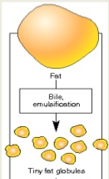
Lipids
Hydrophobic molecules -- challenge to travel through aqueous environments
Digestive mechanisms required to increases solubility of lipid particle
Mechanical forces - emulsification
Bile salts
Emulsification processes
Stability factor
Fat
Emulsification
Fat Globules

Slide 16
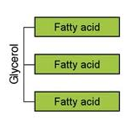
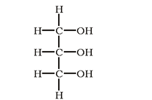
Triacylglycerol Digestion: Mouth and Stomach
Lingual lipase
Glands under tongue
Stimulated by neural factors, high fat diets, mechanical motion in mouth
Works in low pH (stomach), very little digestion occurring in mouth
Specific to:
MCFA on triacylglycerols
sn-3 of glycerol
Produces diacylglycerols and free FAs
sn-1
sn-2
sn-3
Glycerol

Slide 17
Gastric Lipase in the Stomach
Gastric lipase
Secreted by chief cells
Prefers SCFA/MCFA
Works best in low pH (stomach)
But can continue to work in upper small intestine
Specific to sn-1 and-3 of glycerol
Produces di- and monoacylglycerols and free FAs
sn-1
sn-2
sn-3

Slide 18
Triacylglycerol Digestion: Stomach
Emulsification – breaking large lipids into smaller lipids
Starts in stomach
Peristalsis
Wear and tear through sphincter
Fat
Emulsification
Fat Globules

Slide 19
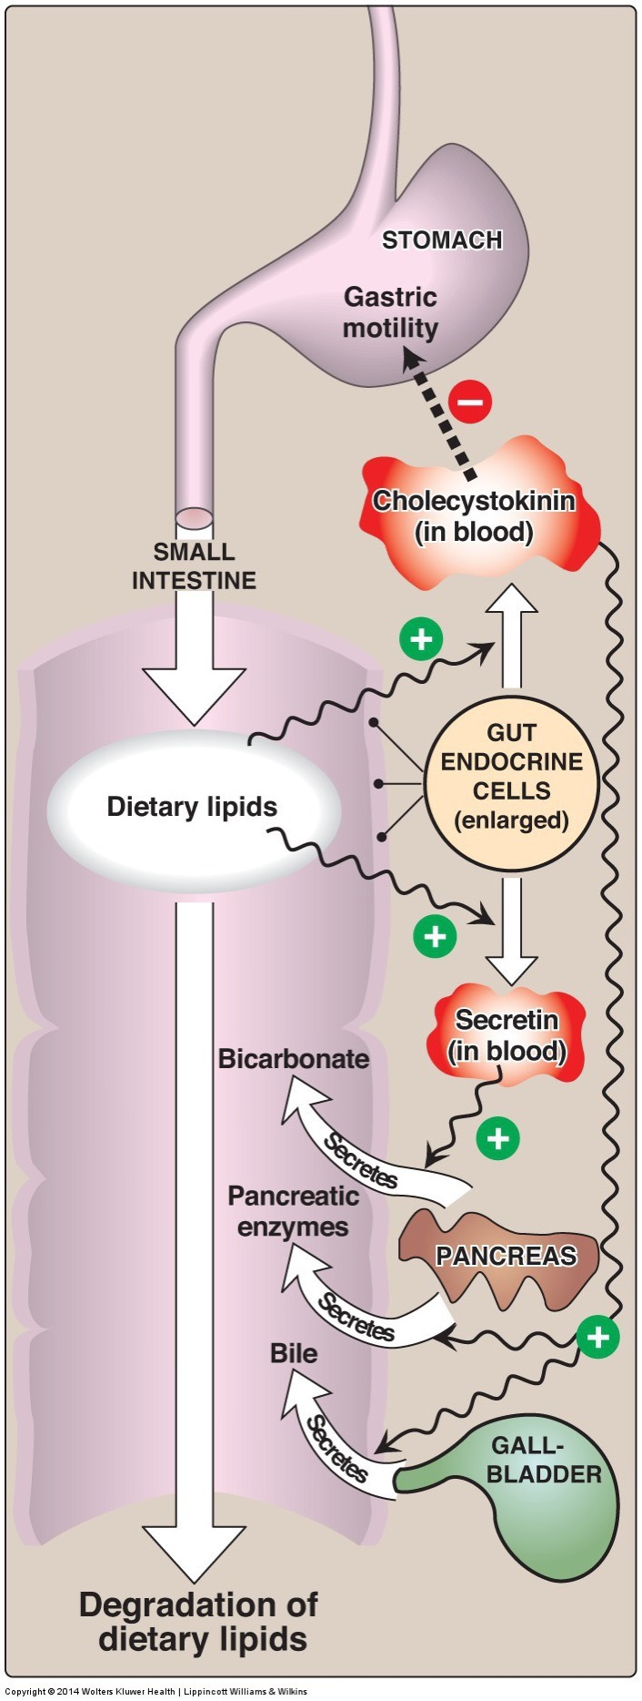
Triacylglycerol Digestion: Small Intestine
Lipid droplets and digestive products enter small intestine
90% of lipid digestion occurs in small intestine
Efficient emulsifiers – bile salts
Allows for greater availability of lipases to reach triacylglycerides
Different lipase (pancreatic lipase) – require less acidic environment

Slide 20
Triacylglycerol Digestion: Role of CCK
CCK activated by peptides and fats in the small intestine and released from enteroendocrine cells (I Cells)
Also stimulated by paracrine signaling from enterocytes and the parasymathetic nervous system
CCK stimulates release of:
Bicarbonate and lipases from pancreas – part of pancreatic juice
Bile from gallbladder
Notes:
Parasympathetic (rest and digest or feed and breed)

Slide 21
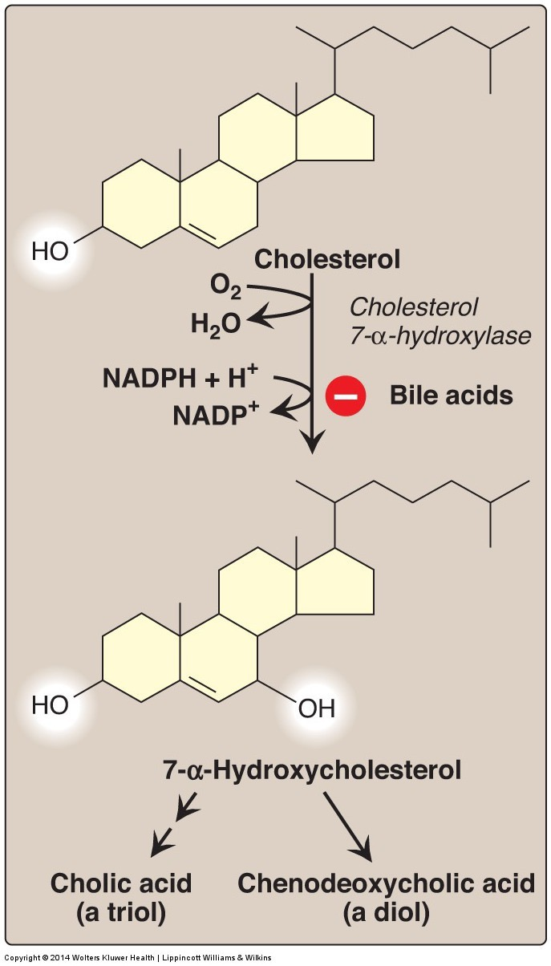
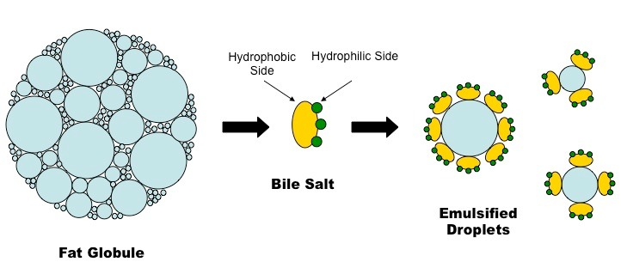
Bile Acid Production
Notes:
Conjugated with taurine

Slide 22
Bile Salts and Intrahepatic Portal Circulation
Cholesterol is converted into bile salts and stored in gall bladder
CCK promotes Bile Release
Contraction of gallbladder
Relaxation of Sphincter of Oddi
~30g per day released per day, 95% of it is recovered in terminal illeum
Shphincter of Oddi

Slide 23
What kind of transport mechanism do you think is needed to fill the gall bladder?
Diffusion
Active Transport
Passive Transport

Slide 24
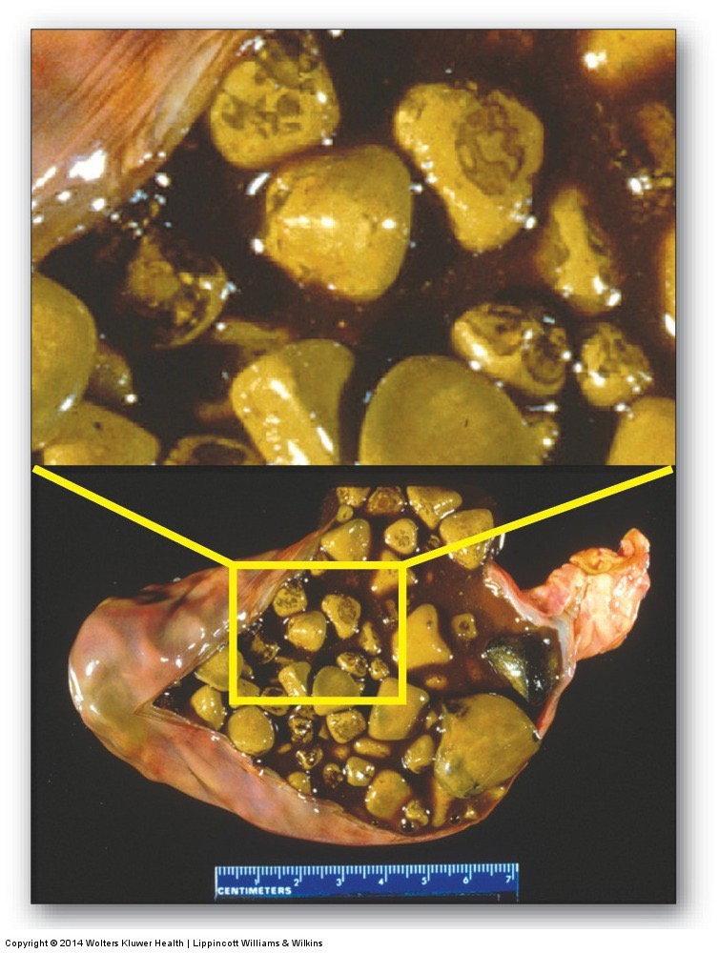
Other problems due to bile salt defects
Cholestasis
Reduced flow of bile
Caused by hepatitis, liver disease, biliary cirrhosis, bile stones or blockages
Poor absorption of fats, vitamins (D/E/K)
Gallstones
Crystalization of bile salts in gallbladder
Associated with too much cholesterol in diet
Cholecystis
Inflammation of gallbladder
Commonly caused by gallstones

Slide 25
Treatment Options for Bile Salt Disorders
Exogenous bile salt supplementation
Low fat diet
Medium chain triglycerides
Oral fat soluble vitamins (A, D, E, and K)

Slide 26
Triacylglycerol Digestion: Small Intestine
Pancreatic lipase activity
–Specific to sn-1 and -3 FA of triacylglycerol
- LCFA
Products include:
Di- and monoacylglycerols (sn2)
Free fatty acids
sn-1
sn-2
sn-3

Slide 27
Pancreatic Lipase Requires Colipase
Pro-colipase secreted by pancreas
Activated by trypsin to colipase (co-enzyme for pancreatic lipase) in small intestine
Colipase required for pancreatic lipase to recognize and bind substrates
Colipase allows pancreatic lipase to bind to lipid droplet = hydrolytic action on droplet
Lipase or Colipase deficiency – results in lipid malabsorption

Slide 28
Orlistat (aka Xenical)
Jarl S, Mark N. XENical in the Prevention of Diabetes in Obese Subjects ( XENDOS ) Study. Diabetes Care 2004; 27:155–61.
What would be some side effects of xenical?
Notes:
4-6lb in other studies.
Steatorrhea
Contraindications for malabsorbtion, reduced gallbladder function and pancreatic diseases

Slide 29
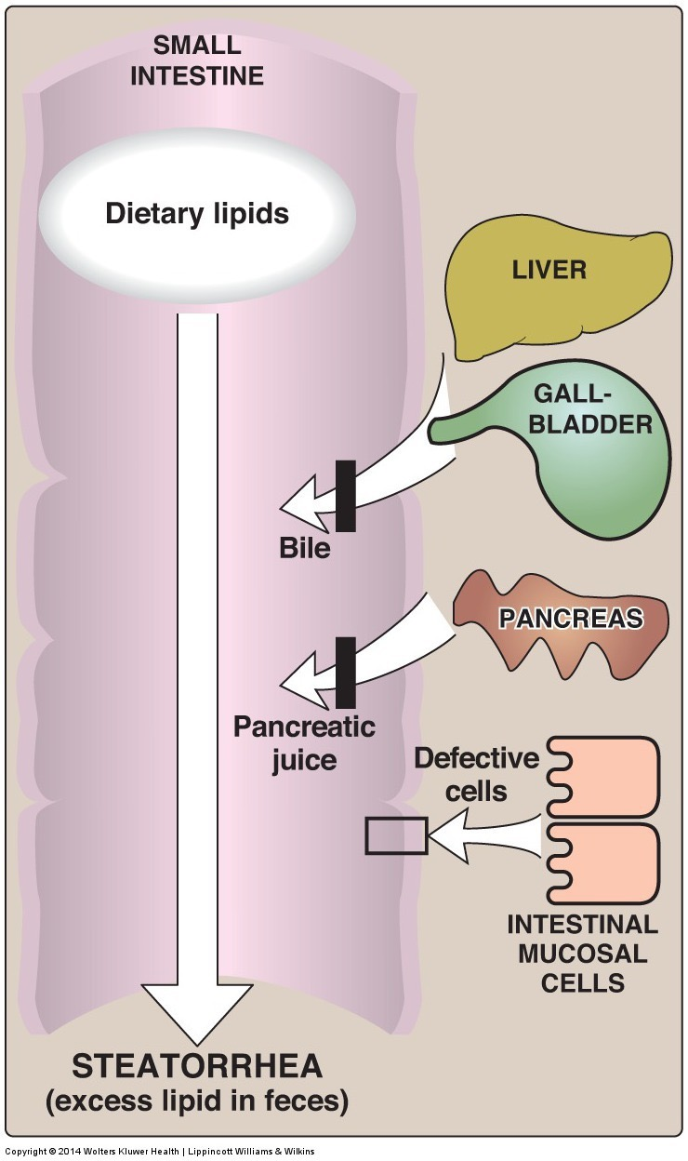
Steatorrhea
Excess fat intake
Decreased digestion
Decreased absorption
Can be caused by inflammation reducing the efficiency of digestion and absorption
Celiac, Crohn’s disease

Slide 30
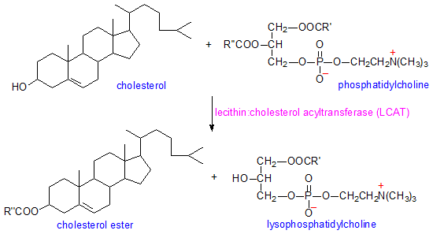
Cholesterol Digestion
Sterol esterase: cleaves fatty acid from cholesterol ester
In small intestine, secreted from pancreas in active form
Esterase
Esterified cholesterol
Cholesterol + Free FA
Fatty acid

Slide 31
Plant Sterols, ABCG5/8 and Sitosterolemia
Plant sterols compete with cholesterol for transporter (NPC1L1)
Can be cholesterol lowering agents
Normally removal of plant sterols from the small intestine is is very efficient (~95%) by ABCG58 Active Transporters
Lack of ABCG5/8 leads to build up of phytosterols in the body which cannot be exported as bile salts this is sitosterolemia

Slide 32
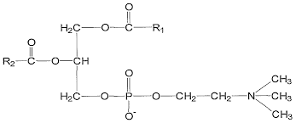
Phospholipid Digestion
Pancreatic phospholipase secreted from pancreas
Phospholipase A2 specific to sn-2 of phosphatidylcholine
Most predominate dietary phospholipid is phosphatidylcholine
Phospholipase A2
Phosphatidylcholine
lysophosphatidylcholine + Free FAs
Fatty acid
Fatty acid

Slide 33
Lipase Worksheet
Lipase | Secreted | Active | Specificity (type, sn and length)
Lingual
Gastric
Pancreatic
Cholesterol Esterase
Phospholipase A

Slide 34
Which lipase would be least affected by antacids?
Lingual Lipase
Gastric Lipase
Pancreatic Lipase

Slide 35
Which lipase function would be most affected by enterokinase deficiency?
Lingual Lipase
Gastric Lipase
Pancreatic Lipase

Slide 36
Lipase Worksheet
Lipase | Secreted | Active | Specificity (sn and length)
Lingual | Mouth | Stomach (pH) | sn3 MCFA/SCFA
Gastric | Stomach (Chief Cells) | Stomach (pH) and SI | sn1/sn3 MCFA/SCFA
Pancreatic | Pancreas (CCK) | SI | sn1/sn3 LCFA Requires colipase
Cholesterol esterase | Pancreas (CCK) | SI | Cholesterol esters
Phospholipase A2 | Pancreas (CCK) | SI | Phospholipids (sn2)

Slide 37
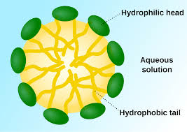
Small Intestine End Products
Products in small intestine:
Fatty acids
Mono- and diacylglycerols
Cholesterol
Phospholipids
Micelle Formation
Micelle

Slide 38
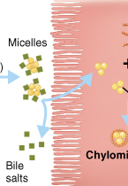
Absorption: Small Intestinal Enterocytes
Lipid contents diffuse out of micelle
Cross apical membrane by diffusion (concentration gradient), passive and active transport mechanisms
Bile salts are either exported from enterocyte or removed during uptake

Slide 39
What happens in the enterocyte?

Slide 40
Absorption: Small Intestine
Digested lipids in enterocyte
FAs with <12 carbons are more soluble
Diffuse into circulation → liver
Transported to liver by albumin
Small and medium chain fatty acids
FA with ≥12 carbons reform (re-esterification) into:
Tri, di-, and monoacylglycerols
Cholesterol esters

Slide 41
Chylomicrons are lipoprotein particles
Re-esterfied lipids and long-chained fatty acids form a chylomicron
Transporter of re-esterfied lipids and long-chained fatty acids out of small intestine
Chylomicron gains a protein and phospholipid coat for solubility – thus considered to be a lipoprotein

Slide 42
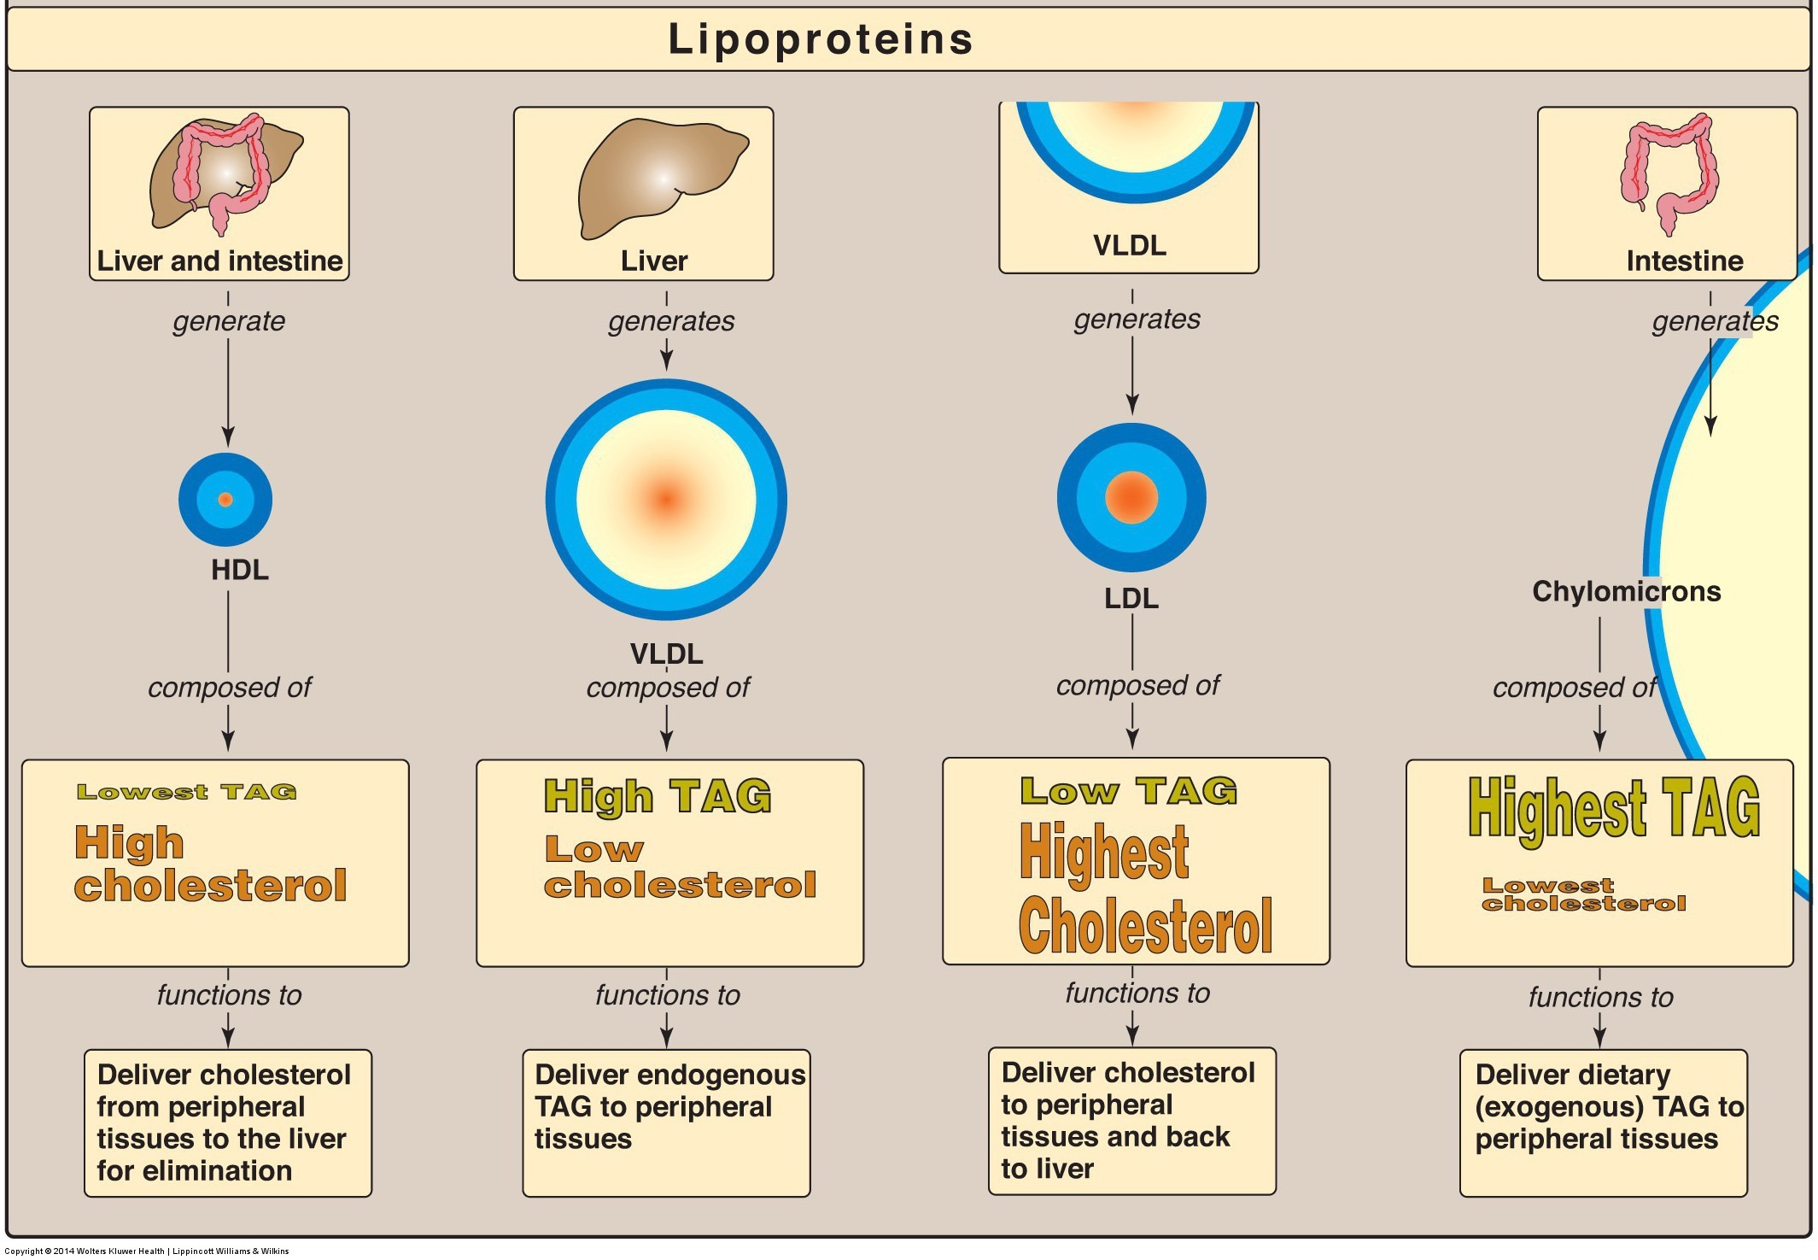
Other Lipoprotein Particles

Slide 43
Apolipoproteins
Apolipoprotein: protein that stabilize lipid particle in aqueous environments
Named by apo + series of letters (A-E) + number
Examples: apoB-100, apoE, apoB-48, etc.
Apolipoproteins have other physiological functions important for lipid metabolism:
Stimulate enzymatic reactions
Regulate metabolic functions such as lipase activity
Specificity towards receptors, targets lipoproteins to particular tissues
LDL contains apo100
apo100 specific to the LDL Receptor (LDLR)

Slide 44
Role of Apolipoproteins and LDL in Triglyceride Transport
Specific apolipoproteins in chylomicrons are ApoA1 and ApoB48 these are added in the enterocyte
They pick up ApoCII/E in circulation
Reiner Ž. Hypertriglyceridaemia and risk of coronary artery disease. Nat Rev Cardiol; 2017; 14: 401–11. doi: 10.1038/nrcardio.2017.31.

Slide 45
Apoproteins
These proteins facilitate lipid solubilization and help to maintain the structural integrity of lipoproteins.
Type Association Function
B48 Chylomicron Carry chol. esters, Lacks LDL receptor binding domain
B100 VLDL,IDL,LDL Binds LDL receptor
C-II Chyl. VLDL, IDL, HDL Activates LPL
C-III Chyl. VLDL, IDL, HDL Inhibits LPL
E Chyl. Remnant, VLDL, IDL, HDL Binds LDL receptor
A-1 HDL/Chylomicron LCAT activator (lecithin:cholesterol acyltransferase)
Slides used with permission from Theresa Han-Markey
Notes:
LPL- Lipoprotein lipase
LCAT- an enzyme that converts free cholesterol into cholesteryl ester (a more hydrophobic form of cholesterol), which is then sequestered into the core of a lipoprotein particle

Slide 46
Chylomicron – Lipid Transportation
Chylomicrons too large to enter capillaries
Exits basolateral membrane into lymphatic circulation
Exocytosed through basolateral membrane via secretory vesicle
Chylomicron bypass liver and enter circulation via lymph system

Slide 47
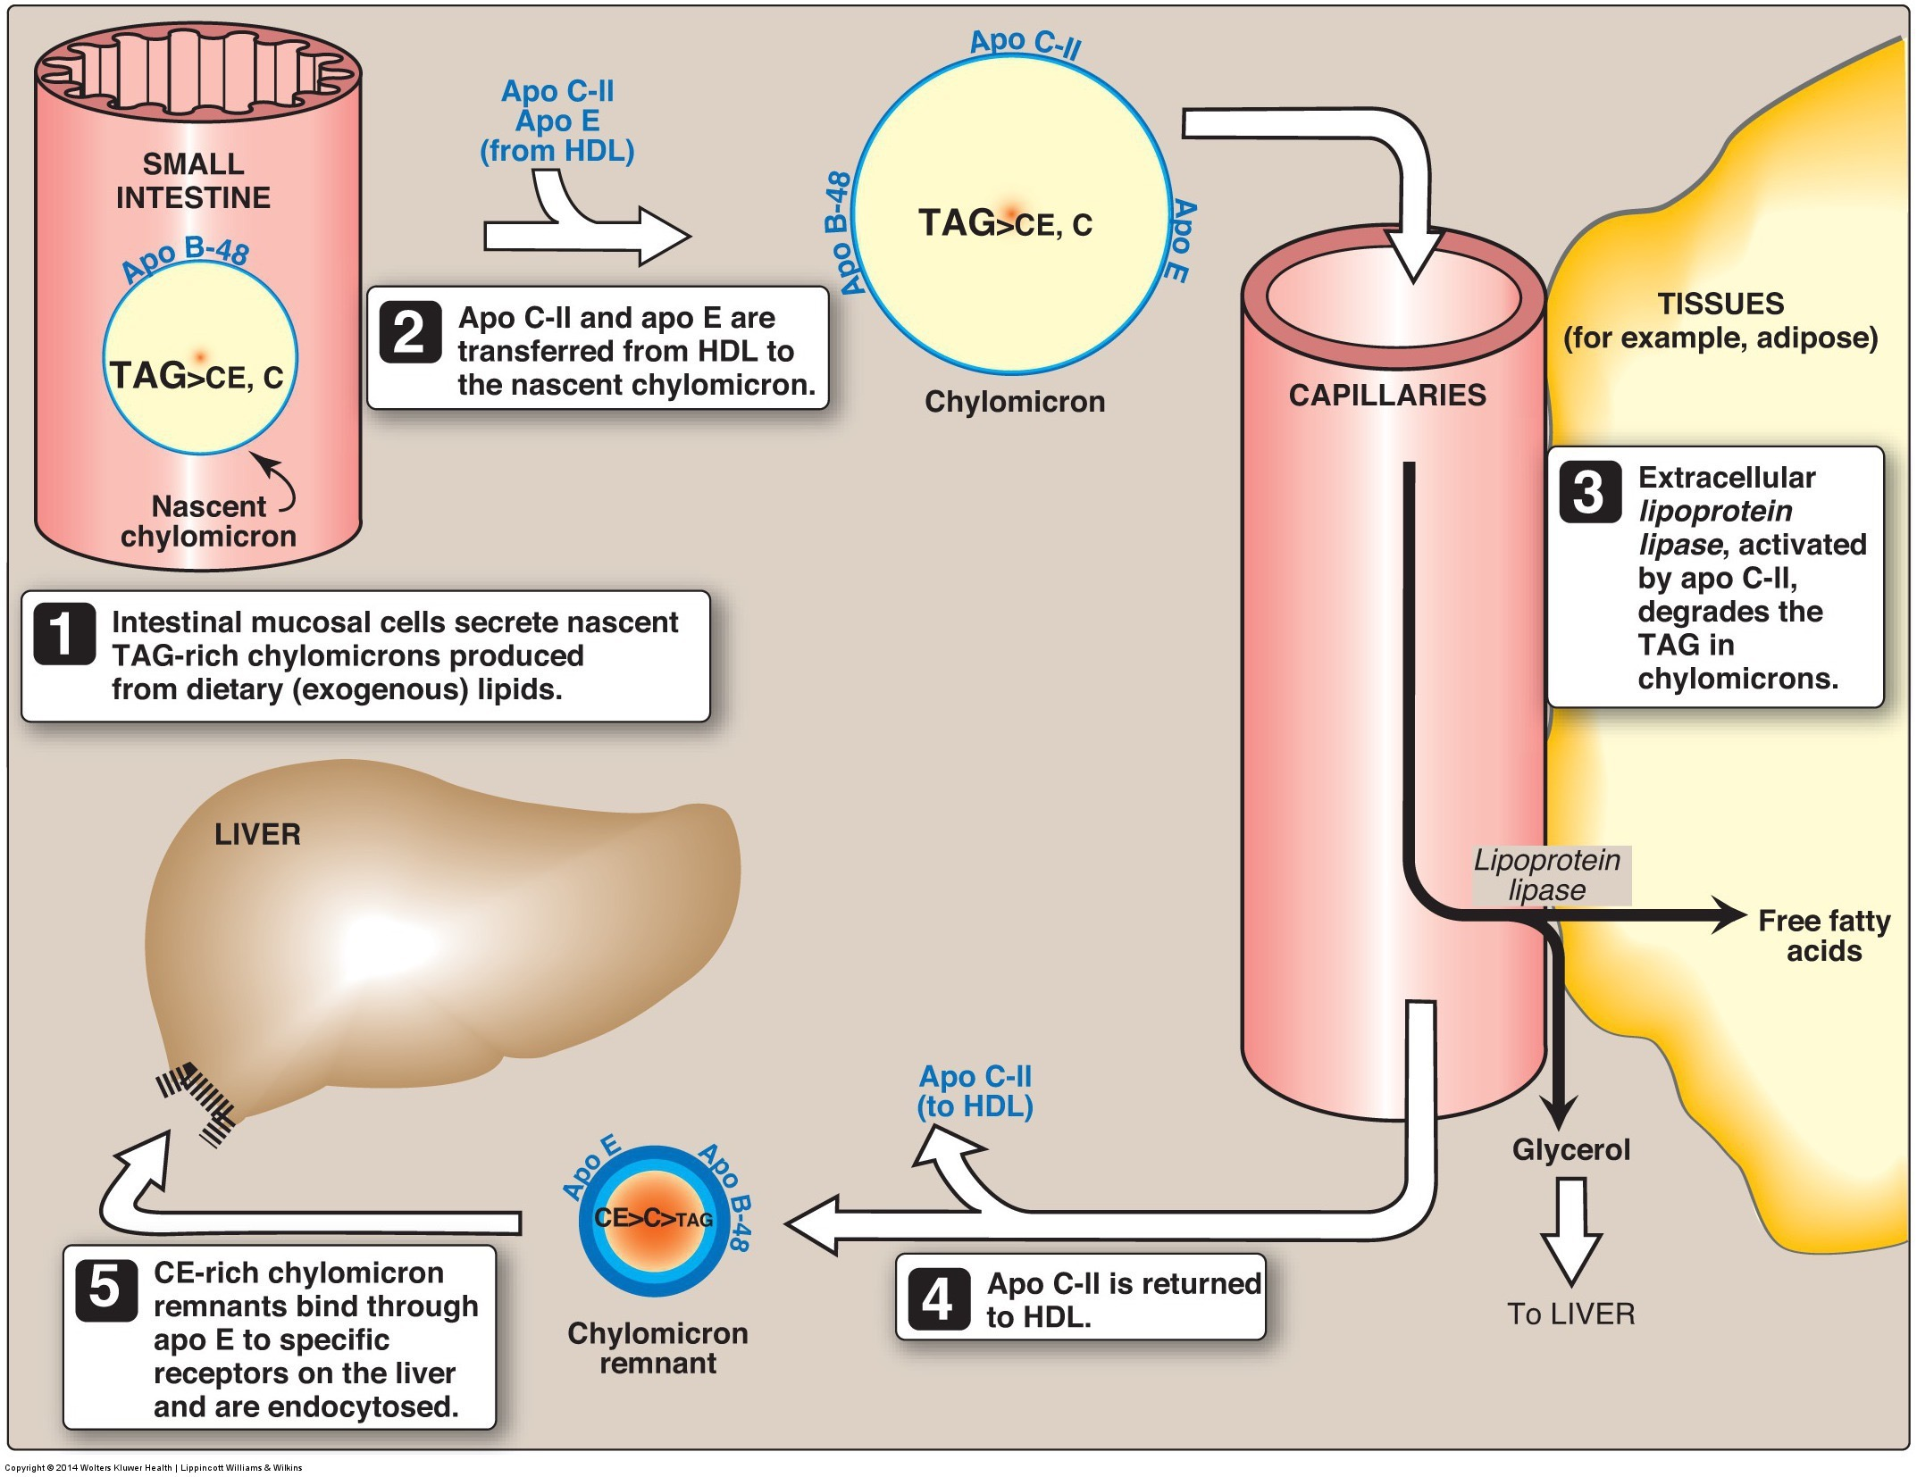
Chylomicrons Transport Lipids to Tissues
Chylomicrons travel mainly to adipose tissue and muscle
Lipoprotein lipase (LPL) – enzyme in endothelial membrane of adipose and muscle tissues
Chylomicron remnant travels to liver
Notes:
ApoC helps LPL recognize lipids
Hydrolyzes FA from mono-, di-, and triacylglycerols of chylomicron
Fatty acids enter tissues
Product of lipoprotein lipase: Chylomicron remnant – rich in cholesterol

Slide 48
Summary
Lipases are enzymes that work to breakdown large lipids to smaller lipids
Lingual/gastric (low pH to function) and pancreatic (higher pH to function) lipase
Lipases, bile, and mechanical forces efficiently emulsify lipids
Micelles made of digested lipids and bile salts form at the brush border
Aides in successful absorption across apical membrane of enterocyte by stabilizing in aqueous environment
Digested lipids (>10 FA HC chain) are re-esterfied in enterocyte
Digested lipids form chylomicron - contains apolipoproteins and phospholipids – before being absorbed across basolateral membrane
Enter lymph system
Transportation of chylomicron results in chylomicron remnant which is cholesterol rich
Chylomicron remnant continues transporting cholesterol to tissue
Eventual formation of IDL, LDL, and HDL

Slide 49
Chylomicron Retention Disease
Laura Gunder
Nutrition 630 LIPIDS 11/15/17

Slide 50
General Information
Other names- Anderson’s Disease, CMRD, CRD
Very rare disease
Inherited- autosomal recessive
Affects absorption of dietary fats and fat-soluble vitamins
Hypocholesterolemic disorder
Notes:
Not to be confused with Andersen disease is also known as glycogen storage disease (GSD) type IV. It is caused by deficient activity of the glycogen-branching enzyme, resulting in accumulation of abnormal glycogen in the liver, muscle, and/or other tissues.
40 studied cases described worldwide- less than 1 in a million
An autosomal recessive disorder means two copies of an abnormal gene must be present in order for the disease or trait to develop.
Dietary fat, which comes from the food you eat, is crucial to the absorption of the fat-soluble vitamins, which includes vitamins A, D, K and E (water-soluble vitamins B and C don't need fat). ... Any vitaminsdissolved in that fat are absorbed into the body as well.
Hypocholesterolemia is the presence of abnormally low (hypo-) levels of cholesterol in the blood (-emia)

Slide 51
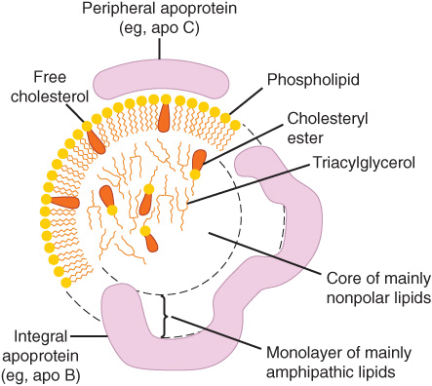
Chylomicrons
Lipoprotein-particles with hydrophobic core and hydrophilic outlayer- amphipathic
Made in the ER of enterocytes- small intestine
Consists of triglycerides, phospholipids, cholesterol, and proteins
3 forms- nascent, mature and remnant
Transport dietary TG and cholesterol to peripheral tissues and the liver

Slide 52
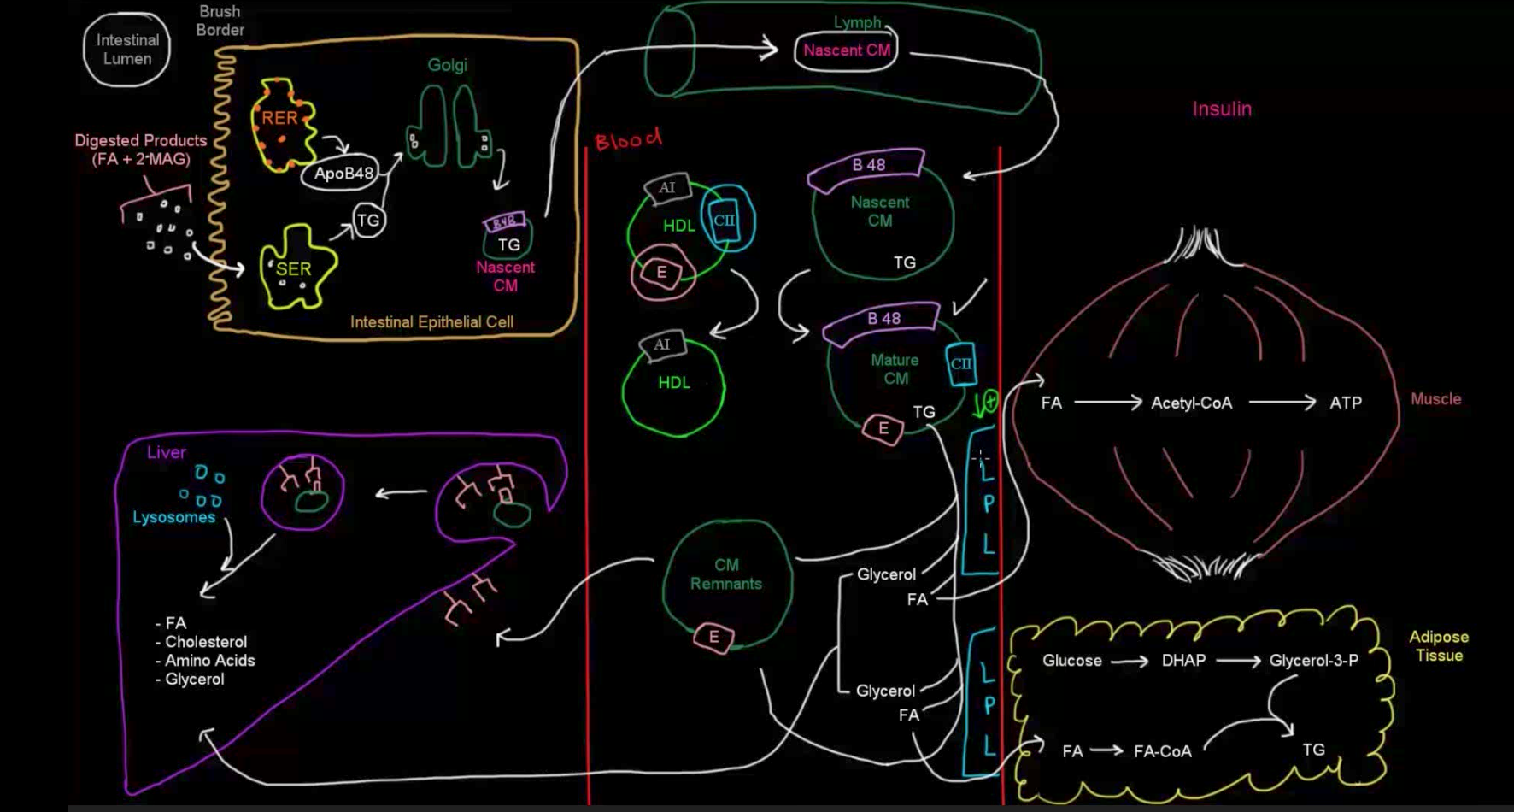
Moof University. Lipoprotein (Part 3 of 7)- Chylomicrons. Youtube. Released Jul 15, 2015 https://www.youtube.com/watch?v=36hZRS_EP7E&t=312s

Slide 53
Symptoms
Usually appear in first few months of life, some symptoms may appear later
Failure to gain weight
Failure to thrive
Chronic diarrhea
Vomiting
Steaotorrhea
Growth defects
Notes:
Other symptoms appear later in childhood
Lead to descreased function of nervous system and decreased reflexes
Steatorrhea (or steatorrhoea) is the presence of excess fat in feces.

Slide 54
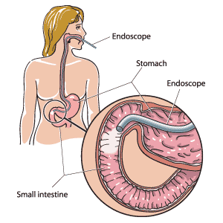
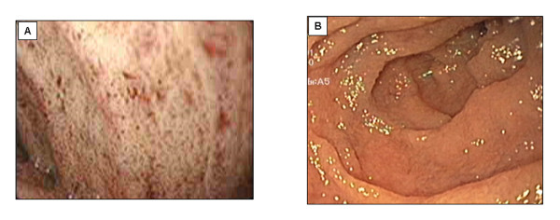
Diagnosis
Difficult because nonspecific symptoms
Abnormal lipid profile
Abnormal fatty acid profile
Endoscopy- white mucosa
Lipid-laden villi
Mutations in SAR1B gene
MediResource Inc. 1996 – 2017.
Notes:
LIPID PROFILE measure the total amount of fatty substances (cholesterol and triglycerides) in the blood
50% reduction in both plasma LDL-C and HDL-C with a normal triglyceride levels.
Abnormal profile, omega 6 linoleic acid deficiency, normal omega 3
ENDOSCOPY white duodenal mucosa on endoscopy

Slide 55
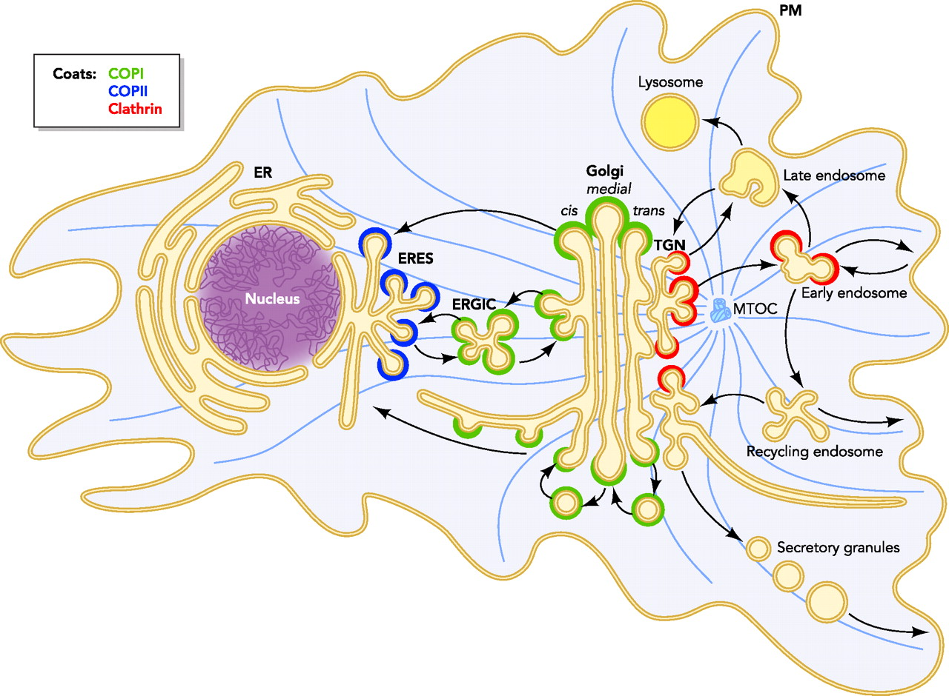
Vesicular transport

Slide 56
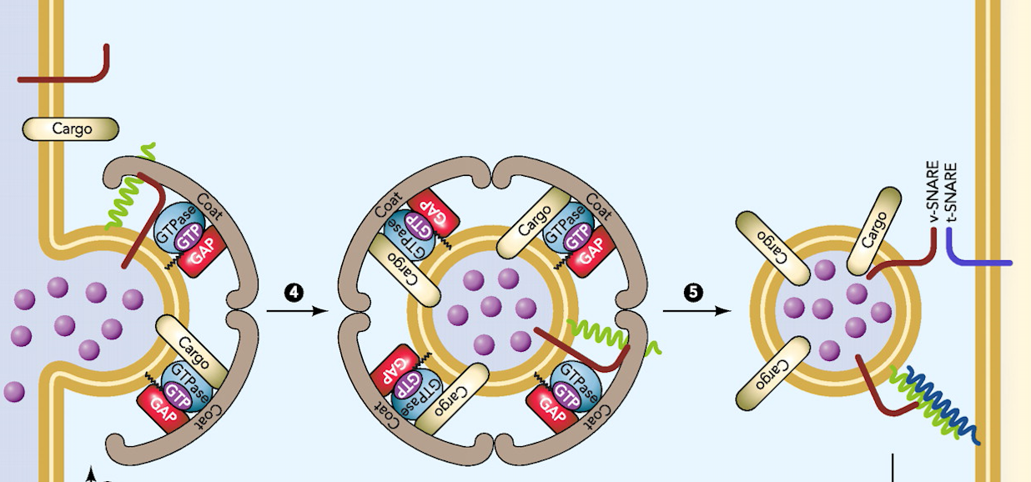
SAR1B
Secretion Associated Ras Related GTPase 1B
Protein responsible for vesicle transport (of chylomicrons) to ER to Golgi:
GTPase- recruits coat complex and effectors to lead formation of vesicles
Coating protein complex COPII
If mutated, accumulate pre-chylomicron transport vesicles in enterocytes
Notes:
Secretion Associated Ras Related GTPase 1B
Recently, the SAR1B gene was identified as responsible for CRD or Anderson's disease (MIM #607689) [8]. The SAR1B gene encodes the Sar1b protein, which is involved in chylomicron transport from the endoplasmic reticulum (ER) to the Golgi apparatus [9,10]. In fact, Sar1-GTP forms a coating protein complex (COPII) with two heterodimers Sec23/24 and Sec 13/31, which initiates budding and captures cargo to eject vesicles from the ER to the Golgi apparatus. When Sar1b is muted, the pre-chylomicron transport vesicle delivered by the ER cannot fuse with the Golgi apparatus, which then induces an accumulation of pre-chylomicron transport vesicles in the cytoplasm of the enterocytes [11-14].
The Sar/Arf family of GTPases plays a major role in recruiting the coat complexes as well as additional effectors that facilitate vesicle formation. However, several Rab proteins also have been shown to participate in this process.
http://physiologyonline.physiology.org/content/26/5/348

Slide 57
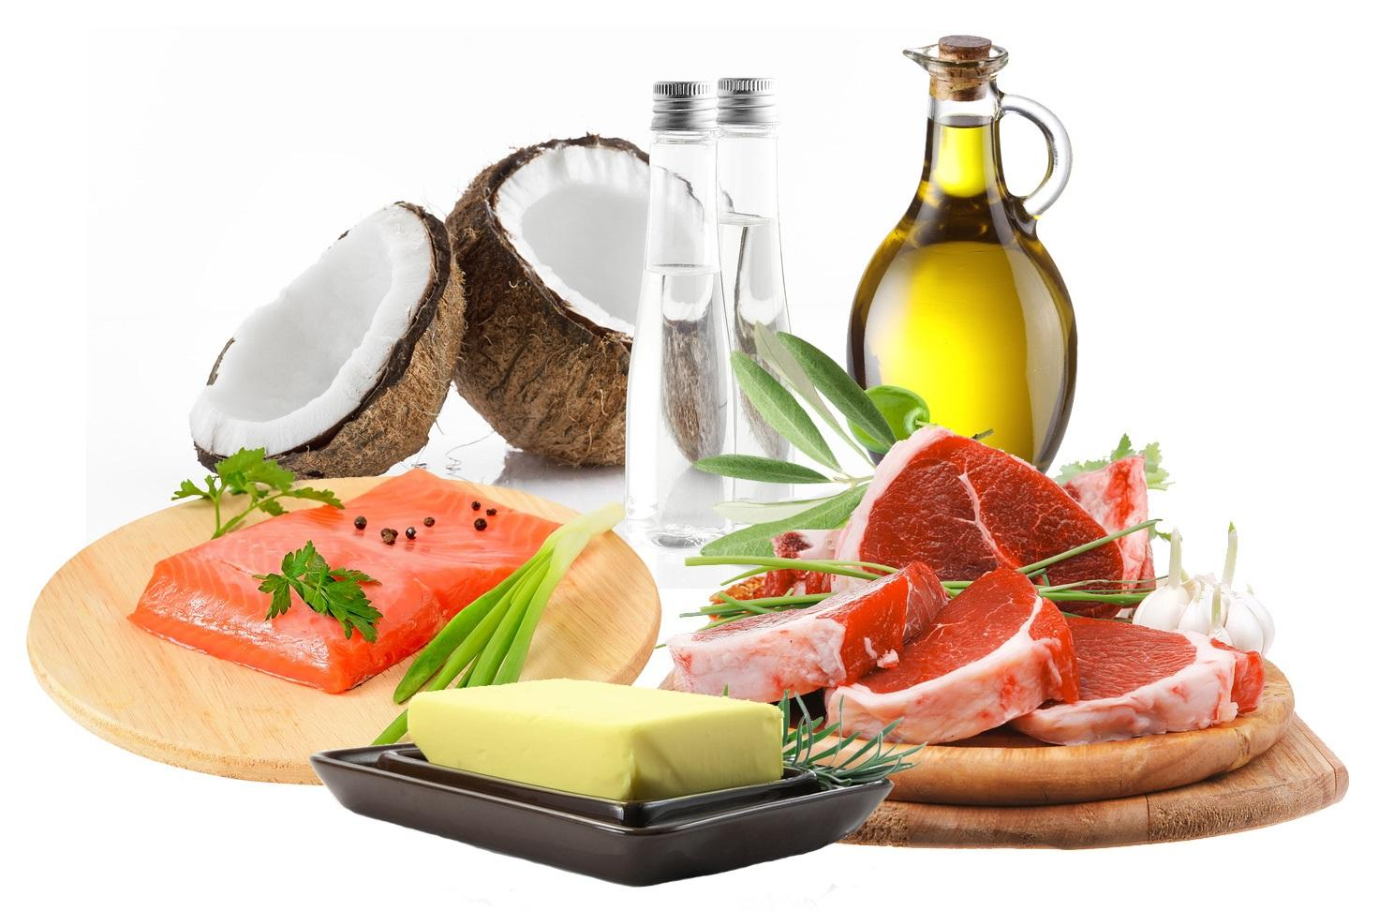
Treatment/Nutritional Intervention
Diet/ Supplementation
Low fat
Essential fatty acids
Medium-chain TGs
Vitamins A, D, E, and K
Fat Soluble Vitamins. http://tabithafarrar.com/fat-soluble-vitamins/ © 2017 Eating Disorder Recovery for Adults
Notes:
Fat malabsorption alters fat-soluble vitamins in variable ways. Vitamin E is the most affected among the liposoluble vitamins in CRD, because its transport is highly dependent on apo B-containing lipoproteins [40]. Vitamin E deficiency is constant at diagnosis in young children. In CRD, the decrease is drastic and most of the time permanent, even with vitamin E supplementation. Vitamin A is often decreased, but easily corrected with oral supplementation. Finally, vitamin D or K insufficiency detected in half the patients can also be corrected with supplements.

Slide 58
Disorder without mutation?
Case of Japanese man with CMRD
All classic symptoms
Normal SAR1B gene coding sequence
Something other than SAR1B involved in chylomicron secretion...
Genotype v. phenotype
Maternal uniparental disomy of chromosome 7
Followed the suggested diet
Low fat, supplemented vitamin E and essential fatty acids, medium chain fatty acids
Notes:
DISOMY the condition of having a chromosome represented twice in a chromosomal complement.
Maternal uniparental disomy of chromosome 7 (matUPD7). An ideogram of chromosome 7 is shown surrounded, on the right, by a portion of the genotypes of the patient and his father and mother
diet restricted in fat accompanied by vitamin E and essential fatty acid supplementation and a 60% Medium Chain Triglycerides (MCT) formula, the diarrhea had improved and the steatorrhea ceased

Slide 59
References
HUTAGALUNG AH, NOVICK PJ. Role of Rab GTPases in Membrane Traffic and Cell Physiology. Physiological reviews. 2011;91(1):119-149. doi:10.1152/physrev.00059.2009.
Okada T, Miyashita M, Fukuhara J, et al. Anderson’s disease/chylomicron retention disease in a Japanese patient with uniparental disomy 7 and a normal SAR1B gene protein coding sequence. Orphanet Journal of Rare Diseases. 2011;6:78. doi:10.1186/1750-1172-6-78.
Peretti N, Sassolas A, Roy CC, et al. Guidelines for the diagnosis and management of chylomicron retention disease based on a review of the literature and the experience of two centers. Orphanet Journal of Rare Diseases. 2010;5:24. doi:10.1186/1750-1172-5-24.
Siddiqi S, Gorelick F, Mahan J, Mansbach II C. COPII proteins are required for Golgi fusion but not for endoplasmic reticulum budding of the pre-chylomicron transport vesicle. Journal of Cell Science 2003 116: 415-427; doi: 10.1242/jcs.00215.
Szul T, Sztul E. COPII and COPI Traffic at the ER-Golgi Interface. Physiology. 19 October 2011.26:5, 348-364. dos: 10.1152/physiol.00017.2011.

